Slide 1
Tutorial #3: Working with Data
Aashik Azim

Slide 2
Working with Data?
Why?
Our application should be available on any client
We have to store ‘state’ of our web application
Topics will be covered:
Firebase Database
How to store data in Firebase Database
How to retrieve data from Firebase and update UI

Slide 3
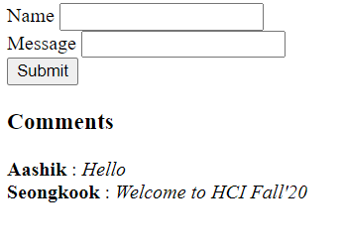
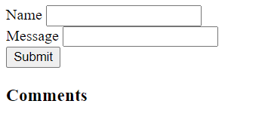
Learning Objective
We will build a comment board
Before any comment is done
After two comments
Give a try: http://www.cs.virginia.edu/~ma6zp/

Slide 4
Firebase
Firebase is a set of services for building web/mobile applications easily
Authentication, Database, Storage, Functions, Crash Analytics, User Analysis, etc.
Why Firebase
Easy to start!

Slide 5
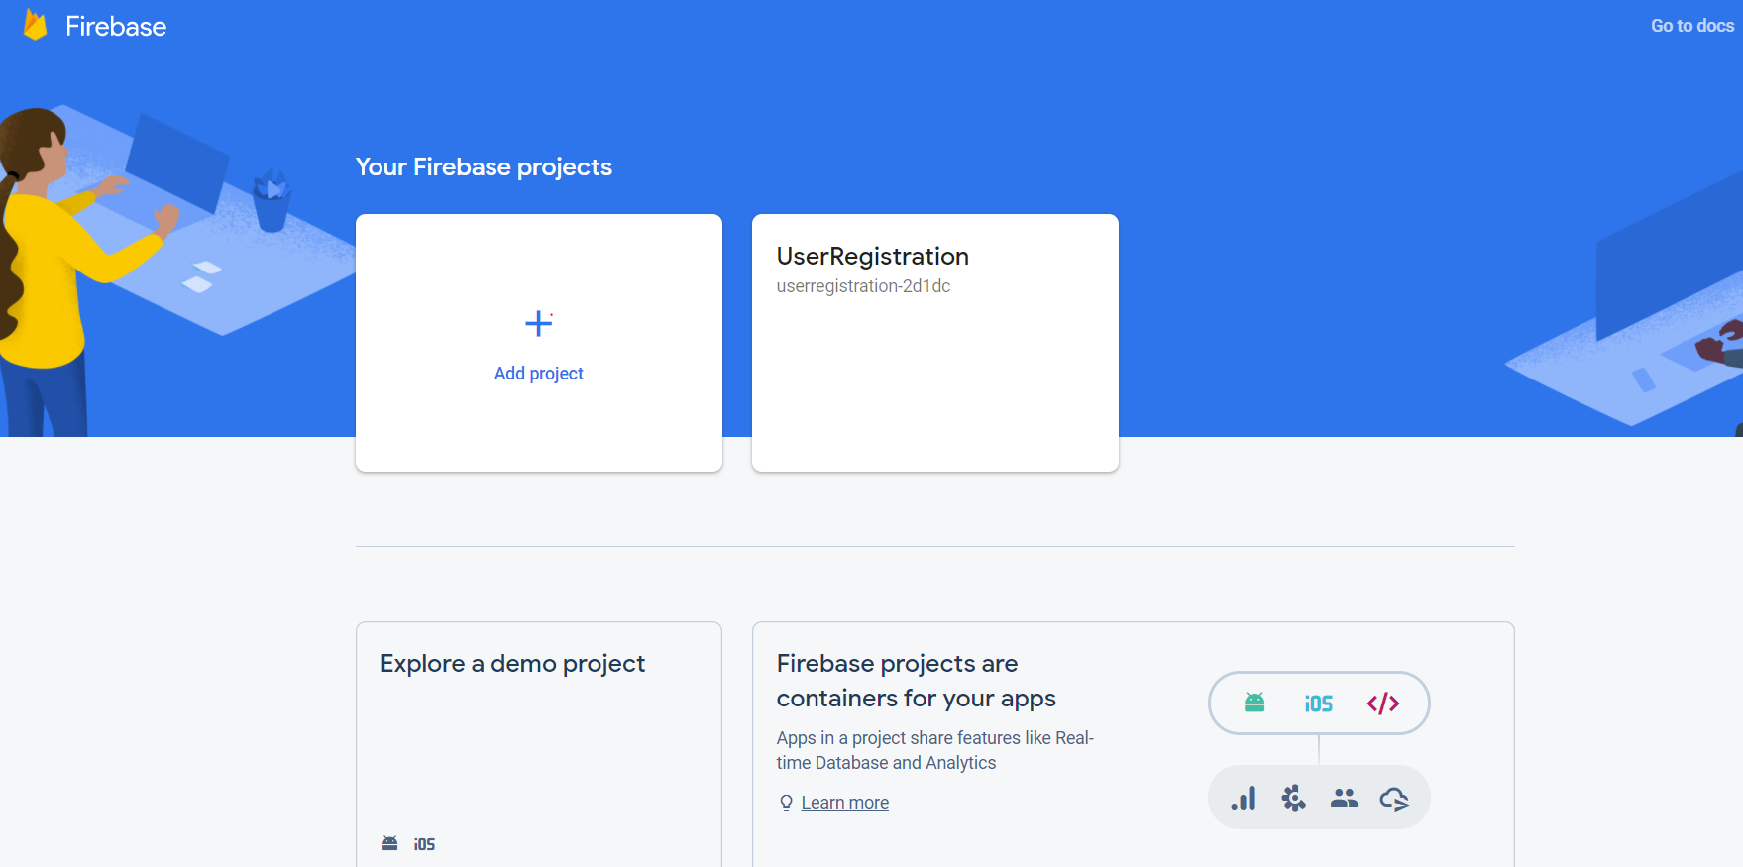
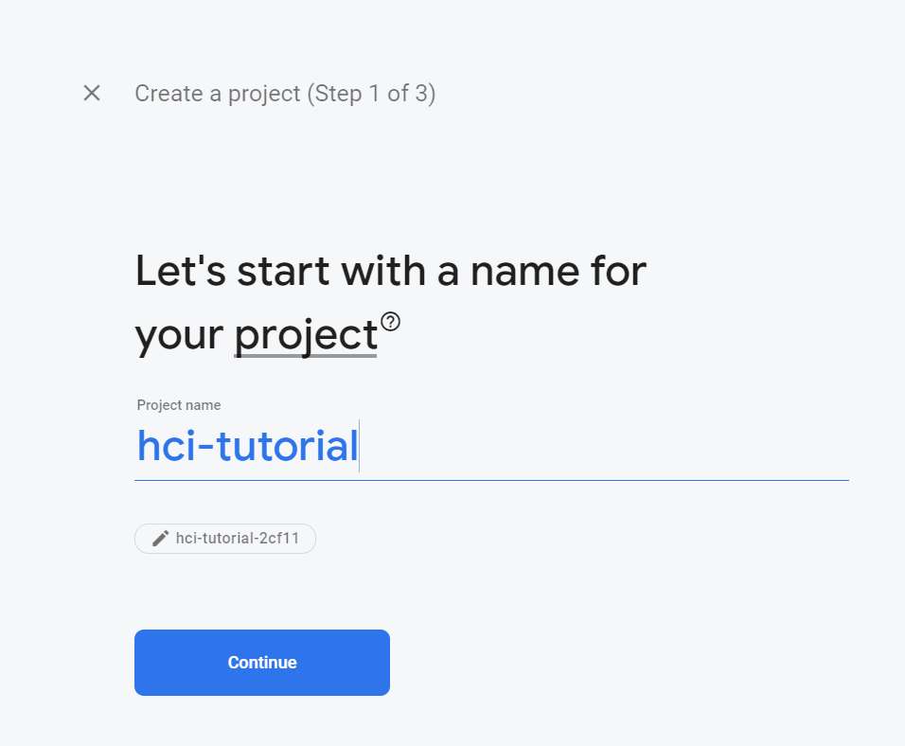
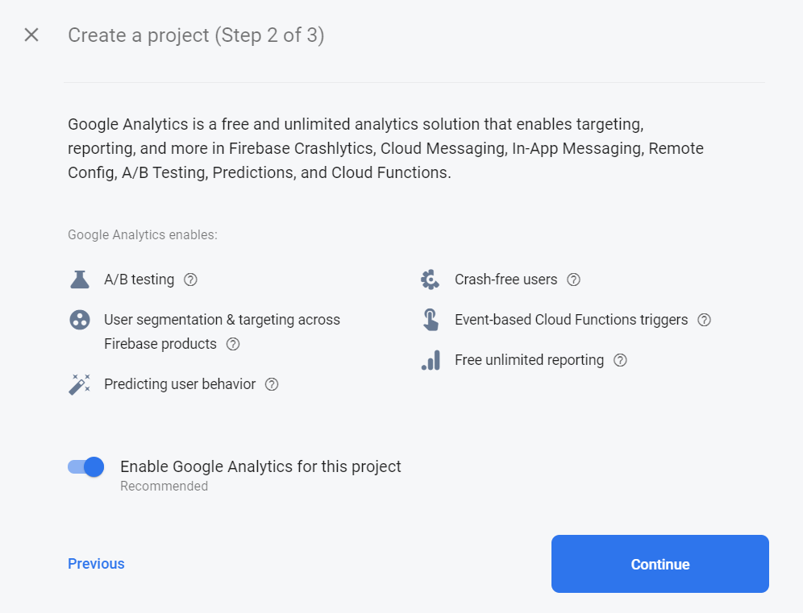
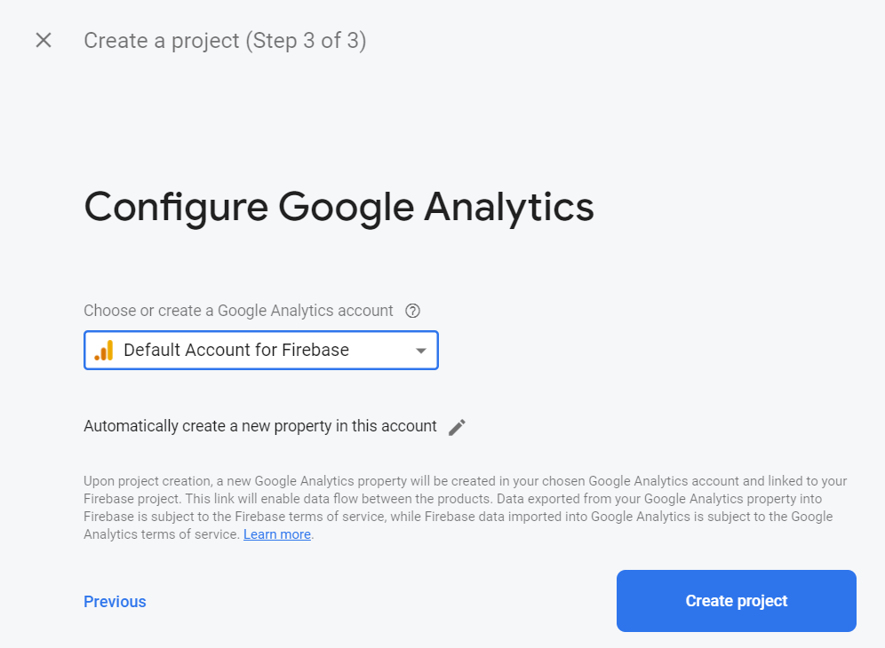
Getting started with Firebase
Prepare a Google account
Go to the https://firebase.google.com/
Start a new project

Slide 6
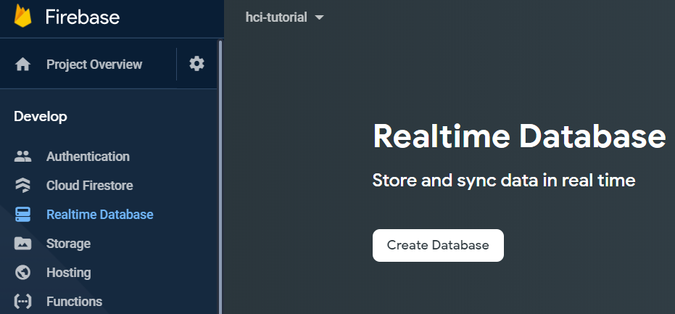
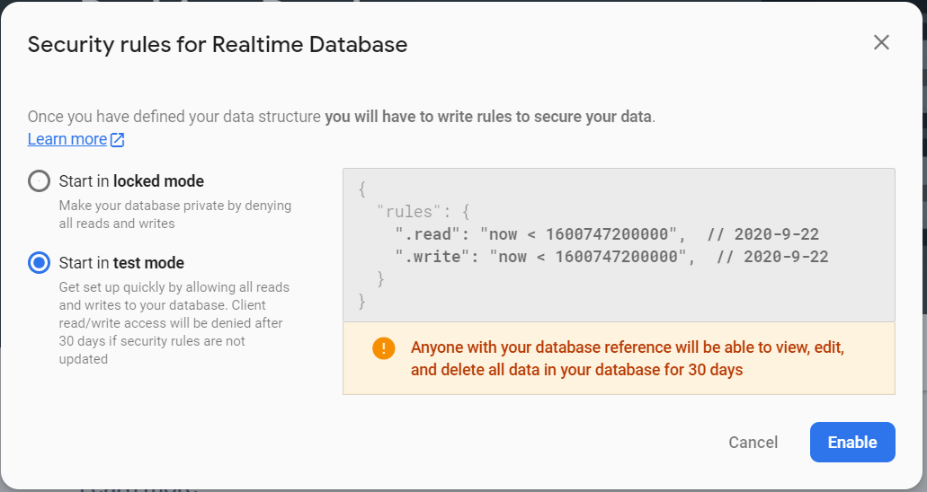
Firebase Database
From hci-project, we will create a database
Two types of databases
Cloud Firestore
Realtime Database
We will use Realtime Database
For this tutorial, let’s use the test mode one

Slide 7
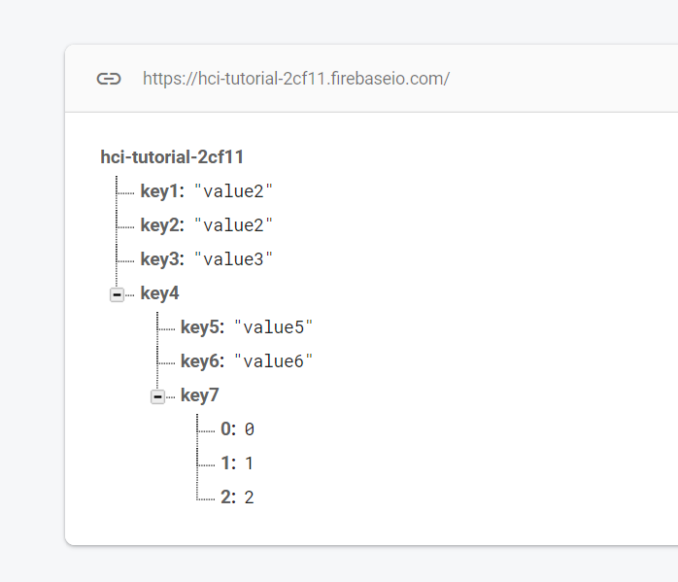
Firebase Database Structure
Data should be stored in Key/Value (pair) structure
Define your application state into Key/Value structure
Keys: key1, key2, key3…
Value: value1, value2, value3,…
Nested key/value:
Key: key4
Value: Object → key/value (second level nesting)

Slide 8
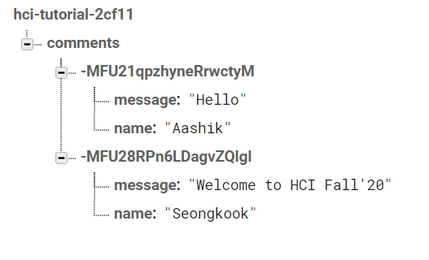
Storing Data of Comment Board

Slide 9
Firebase Database - Realtime
When the data change
Firebase emits event noticing the data changed
We will use this property to keep our UI up-to-date

Slide 10
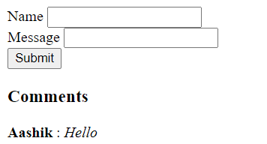
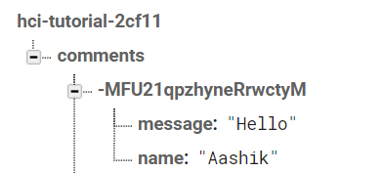
Data Flow
Fetch

Slide 11
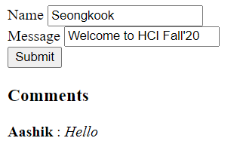
Data Flow
Fetch
Update

Slide 12
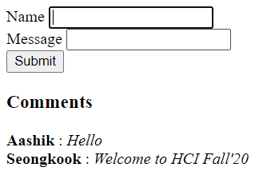
Data Flow
Fetch
Update
Fetch

Slide 13
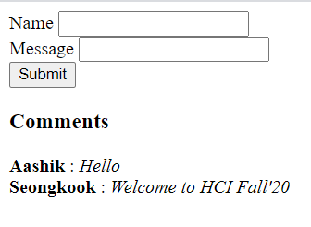
TODO1: Bind UI data
Bind
Update in data
→ Update in UI

Slide 14
TODO2: Update Firebase database
Update

Slide 15
Setting up Firebase
Import Firebase JS SDK in your code:
<script src="https://www.gstatic.com/firebasejs/4.0.0/firebase.js"></script>
Import jQuery
<script src="https://ajax.googleapis.com/ajax/libs/jquery/3.5.1/jquery.min.js"></script>
https://firebase.google.com/docs/web/setup
Web API key
Database URL

Slide 16
Write a HTML with Form to submit Write the code after me on visual code

Slide 17
Accessing Firebase Database
https://firebase.google.com/docs/database/web/start
We need ‘ref’ ← Reference to subject of whole database
firebase.database().ref(comments)
firebase.database().ref(comments/MFU21qpzhyneRrwctyM)

Slide 18

Subscribing to Ref
Ref.on(‘value’, callback)
Call callback when ref is updated
We will update comments every time ref is updated
Called once when ref is created
Update
render

Slide 19
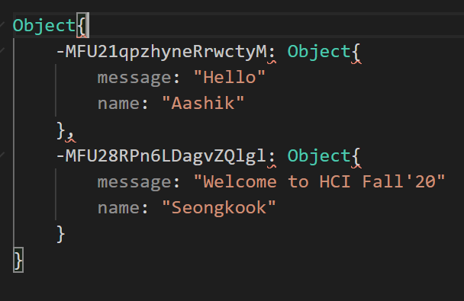
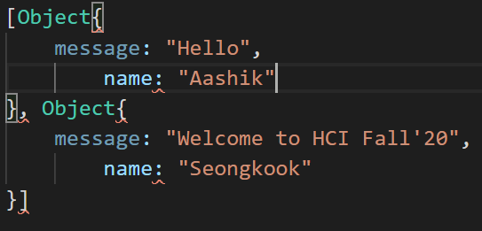
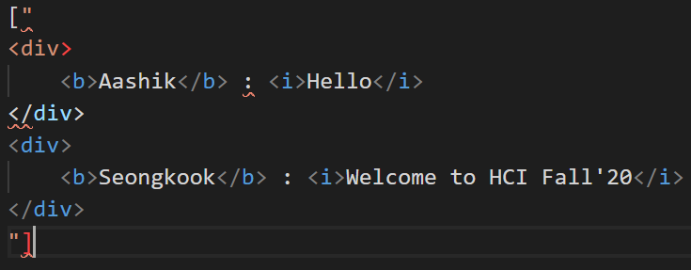
Updating UI with Data

Slide 20
Push Data
Ref.push(value)
Add a new entry with new key and value
‘value’ event in Ref.on(‘value’,callback) will fire and ‘callback’ will be called
Our UI will be rendered again with new data

Slide 21
What we learned?
How to start Firbase project and database
How to listen to firebase database and bind UI
How to add item to firebase

Slide 22
Thank You!
Questions?

